Slide 1
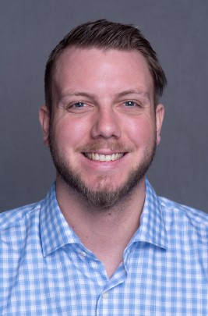
David Drews Consultant
Email
david.drews@thebridge.com
Location
Chicago, IL
Mobile
(630) 396-0017
David joined The Bridge in September 2023. He previously worked at Millennium Trust Company for just under three years. He worked as a team lead for a team of 18 members within Transaction Services. He also volunteered as a scrum master where he learned about AGILE and grew his project management knowledge.
EXPERIENCE
Industry Experience
Financial Services | Food Distribution
IT Management Consultant | The Bridge
Coordinate a massive Procurement transformation from five host systems into one system for business and client needs
Run daily SWAT meetings with Business, IT and Data Services to effectively go through tasks and set timelines
Manage the RAID logs, risk/issues registers and other project-related tasks to assist the Project Manager
Facilitate two JIRA boards for Host IT and Data Services.
Create hundreds of tickets for discrepancy tracking
Run daily stand ups for the teams
Organize the backlog and assign out work
Track metrics for these tickets
Team Lead and Volunteer Scrum Master | Millennium Trust Company
Created and assigned out all work for our 18 team members on our transaction services team.
Approved all our teams work to get wired out up to $1.5 million
Ran two projects as the business leader from our department to facilitate our project manager and scrum master’s inquiries to help build two departmental projects
Volunteered as a scrum master on an AGILE team in tandem with my above position
BACKGROUND
Functional Skills
Project Coordination, PowerPoint, Excel, Meeting Facilitation, People Management, Business Development, Time Management, Communications
Qualifications
(CSM) Certified Scrum Master
(PSM1) Professional Scrum Master
Master

Slide 2

Email
david.drews@thebridge.com
Location
Chicago, IL
Mobile
(630) 396-0017
David joined The Bridge in September 2023. He previously worked at Millennium Trust Company for just under three years. He worked as a team lead for a team of 18 members within Transaction Services. He also volunteered as a scrum master where he learned about AGILE and grew his project management knowledge.
David Drews Consultant
Acceleration

Slide 3
David Drews Consultant
Email
david.drews@thebridge.com
Mobile
(630) 396-0017
Location
Chicago, IL
BACKGROUND
EXPERIENCE
Functional Skills
Project Coordination, PowerPoint, Excel, Meeting Facilitation, People Management, Business Development, Time Management
Qualifications
(CSM) Certified Scrum Master
(PSM1) Professional Scrum Master
Master
Industry Experience
Financial Services | Food Distribution
IT Management Consultant | The Bridge
Coordinate a massive Procurement transformation from five host systems into one system for business and client needs
Run daily SWAT meetings with Business, IT and Data Services to effectively go through tasks and set timelines
Manage the RAID logs, risk/issues registers and other project-related tasks to assist the Project Manager
Facilitate two JIRA boards for Host IT and Data Services.
Create hundreds of tickets for discrepancy tracking
Run daily stand ups for the teams
Organize the backlog and assign out work
Track metrics for these tickets
Team Lead and Volunteer Scrum Master | Millennium Trust Company
Created and assigned out all work for our 18 team members on our transaction services team.
Approved all our teams work to get wired out up to $1.5 million
Ran two projects as the business leader from our department to facilitate our project manager and scrum master’s inquiries to help build two departmental projects
Volunteered as a scrum master on an AGILE team in tandem with my above position

